Slide 1
TDL Assignment
Presentation
Sehun Babatunde

Slide 2
Introduction
I’m Sehun :)
Joined QA – December 2020
Always had a interest in technology (video games FTW!) Graduated from a software engineering degree in July 2020

Slide 3
Consultant Journey
Git (Three feature branch model) & Github
Java Programming Language
OOP Concepts
Project Management (Jira, user stories, acceptance criteria)
Unit Testing (JUnit)
Maven
MySQL (SQL,Workbench)
New: Mockito, Selenuim, HTML, CSS, JavaScript

Slide 4
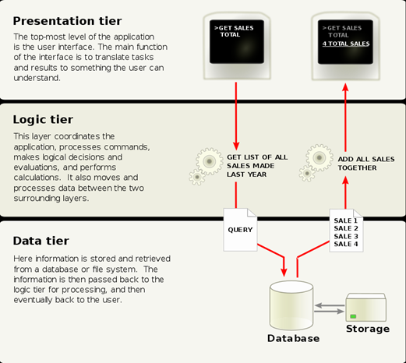
Approach - Previous CRUD Applications
Prescription Management site via LAMP stack
(Linux, Apache MySQL,PHP)
Dissertation - mobile app art marketplace – CRUD functions (Add users, add art)
IMS Assignment – Aim to improve
Password Generator Weekend project – Improve and practice my skills and knowledge of HTML, CSS, Javascript, understanding DOM, HTML elements etc
Three Tired Model
Three- Tiered Architecture model

Slide 5
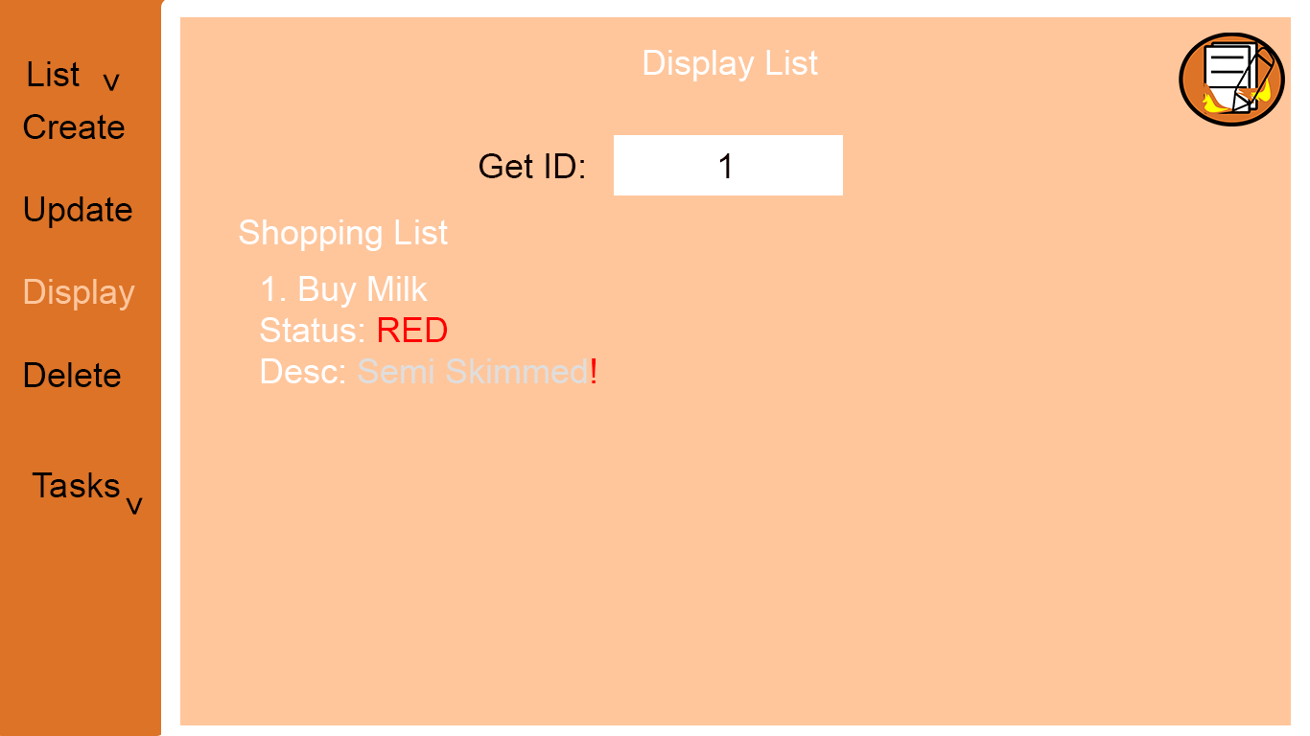
Design Draft

Slide 6
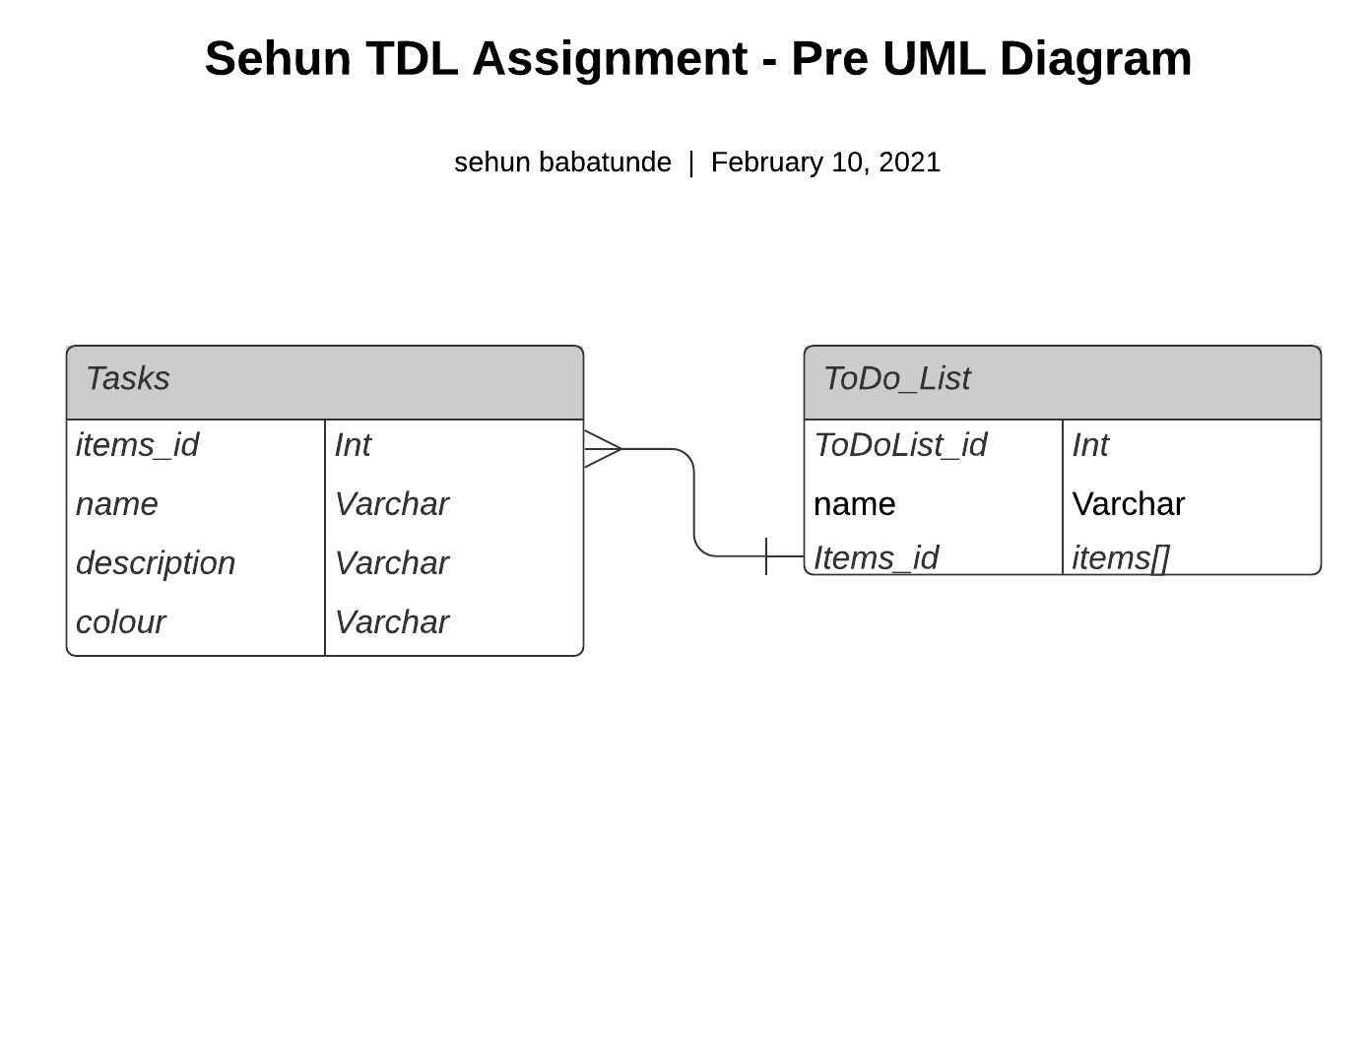
ER Diagram

Slide 7
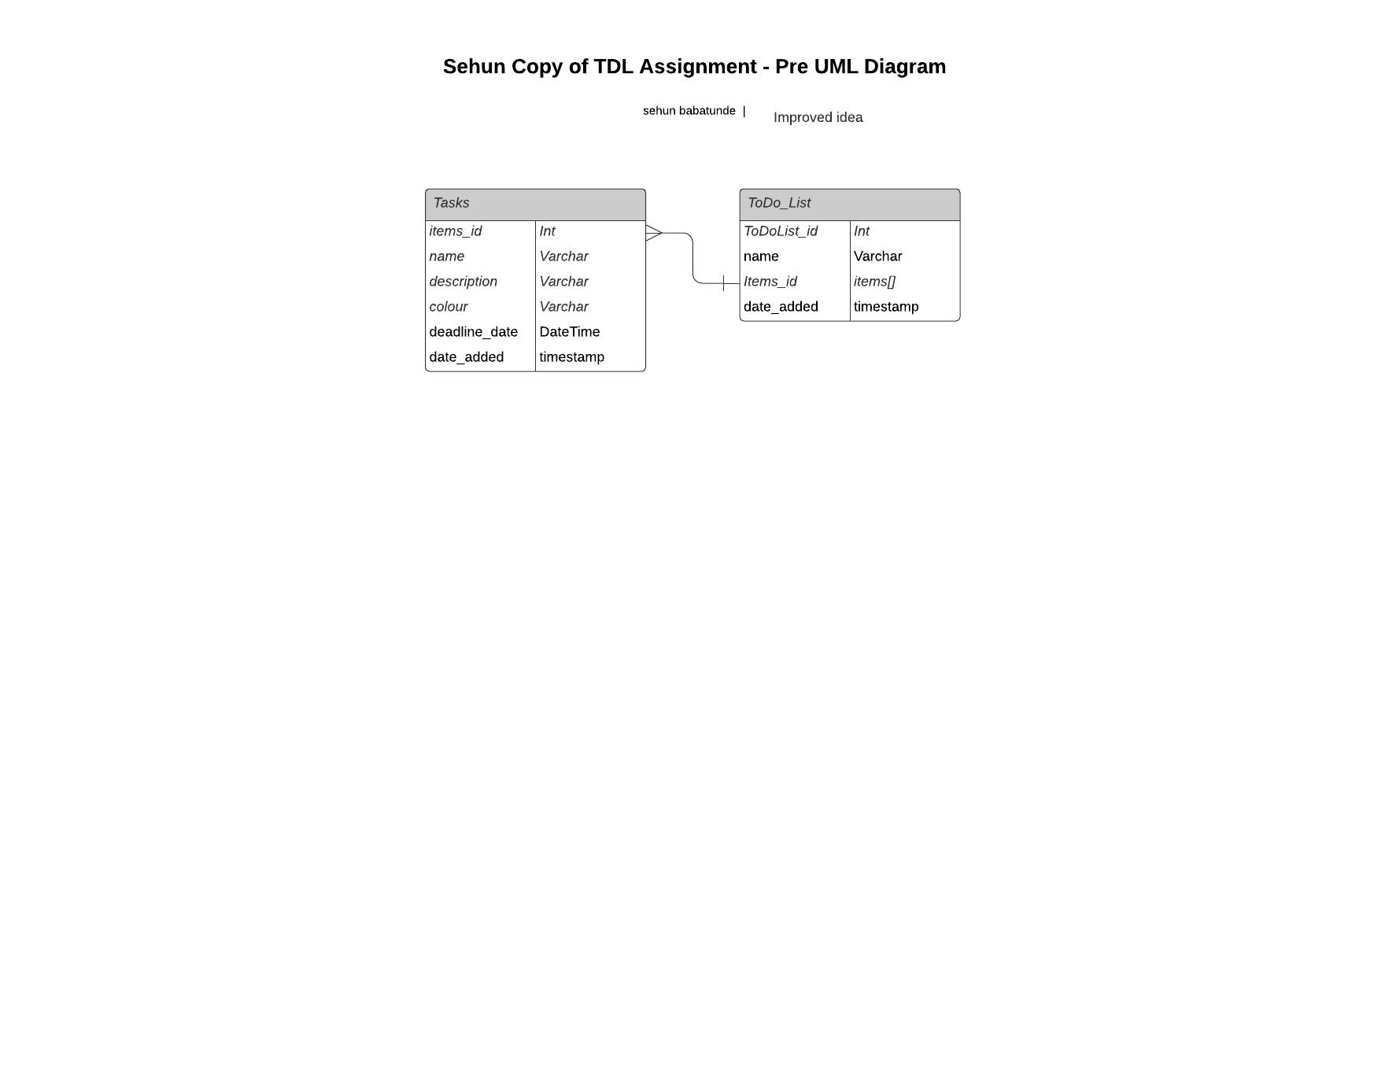
ER Diagram

Slide 8
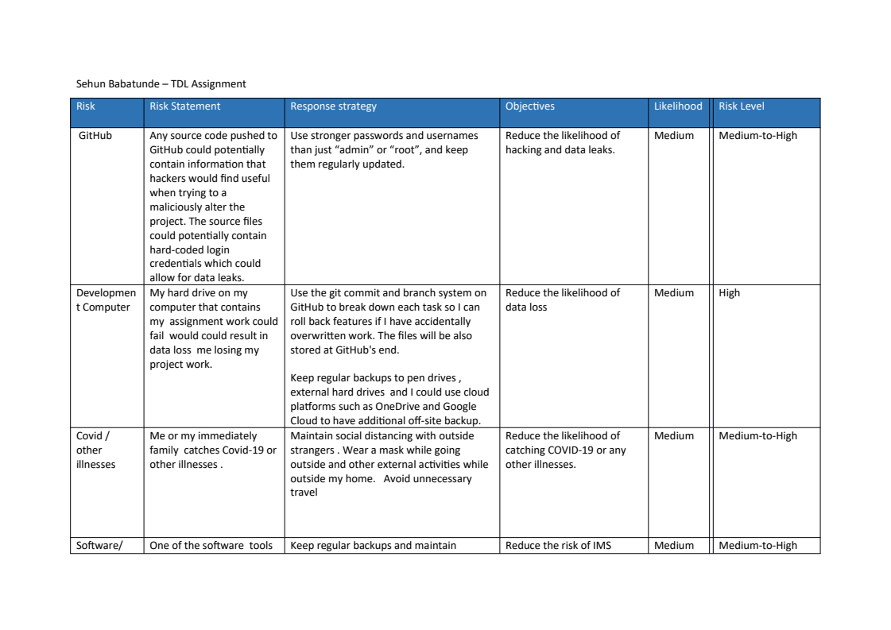
Risk Assessment

Slide 9
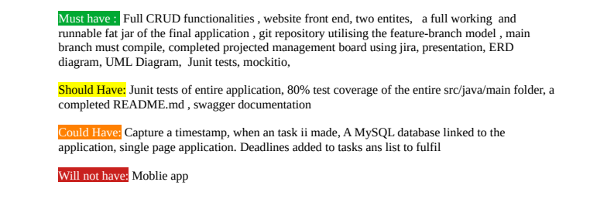

Slide 10
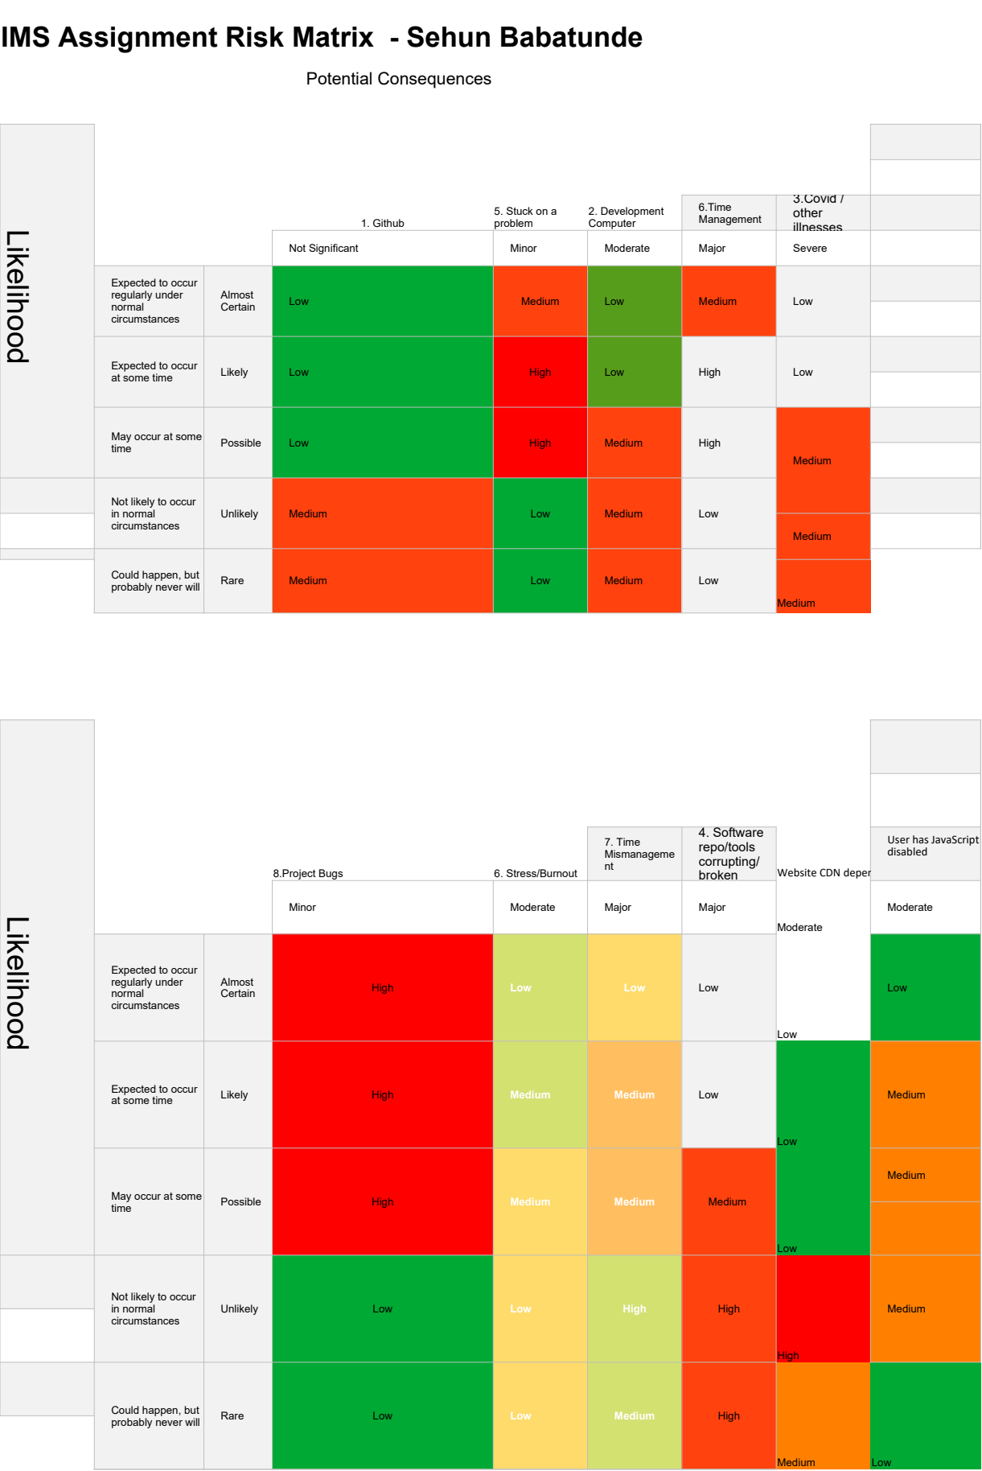

Slide 11
CI – Version Control
The o’l reliable:Three feature branch Model
Benefits: Continues Integration & Development
Don’t break the main branch
Rollbacks!

Slide 12
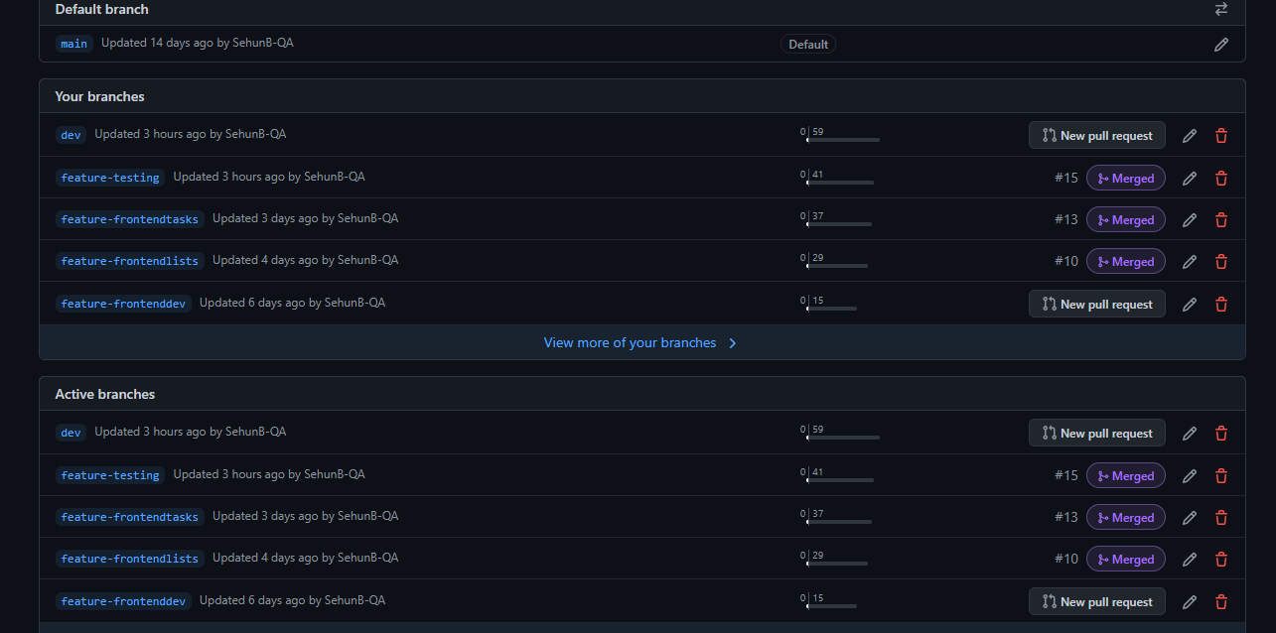

Slide 13
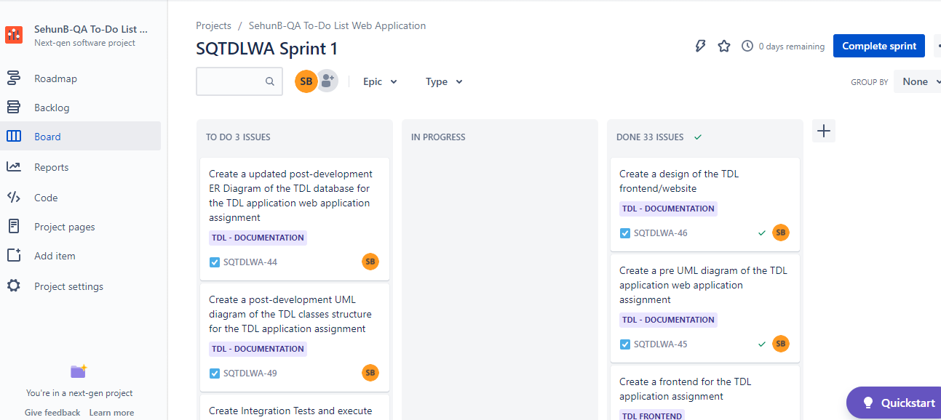

Slide 14
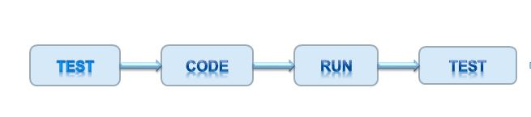
Testing
Why use JUnit & what's the purpose of Unit Testing? –
To confirm that our program and it’s behaviour works as intended!
We also used Mockito & Selenium
Mockito – Mock class functionality
Selenium – Test Front end

Slide 15
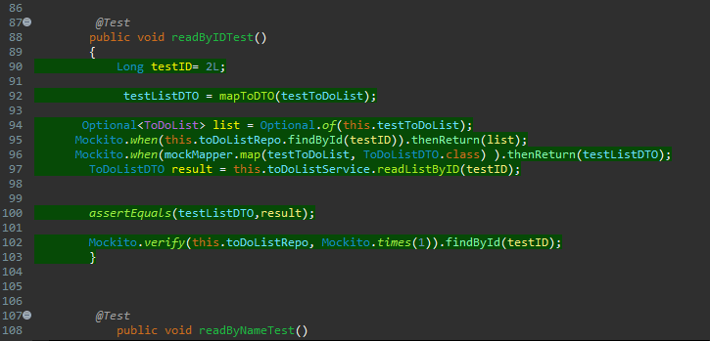
Mockito can perform fake operations mapping our actual functions!

Slide 16
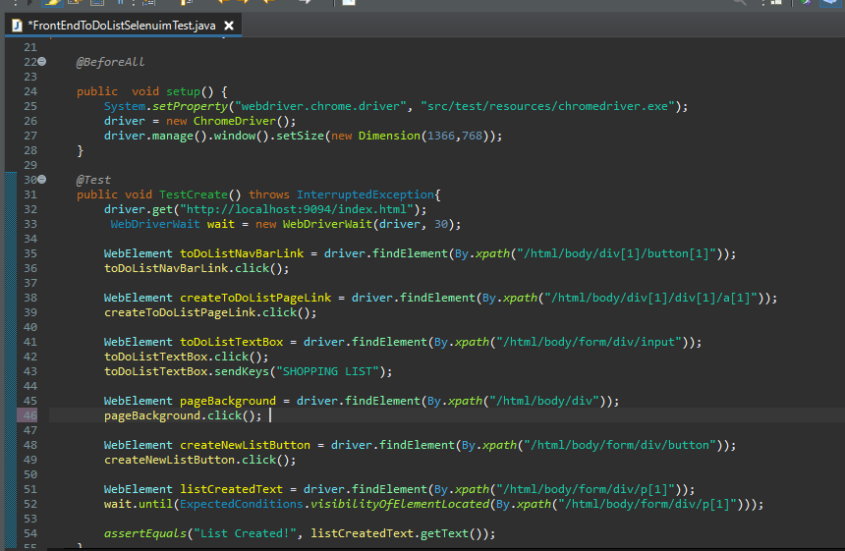

Slide 17
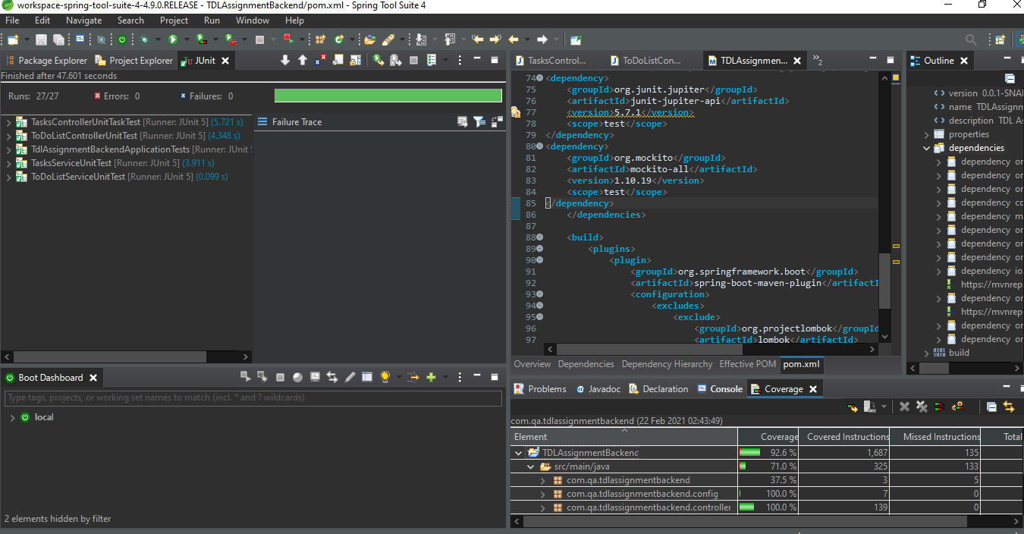

Slide 18
The Fun Part: The demo!

Slide 19
Sprint Review
Jira Board - https://sehunqaimsassignment.atlassian.net/jira/software/projects/SQTDLWA/boards/2
Complete: Full working frontend and backend , unit tests of controllers, most unit tests of services, front end test of todolist
Left of: Junit testing of update function in services, integration tests,

Slide 20
Sprint Retrospective
Overall : Went well and helpful
Improved test coverage and skills from last project
Things to improve:More breakdown of tasks
Full Junit tests of the services, integration tests, 80+ test coverage

Slide 21
Conclusion
Successes :
I have learned a lot
Proud of project
Good Challenge & working project
Met great people
Improvements and moving ahead:
-Don't overstress
- Have regular updates with my trainers
- Do some more learning on concepts covered (especially testing Mocktio, Repos,Services etc)
- Better management on time and tasks

Slide 22
Questions?
Thank you for listening! :)

